Slide 1
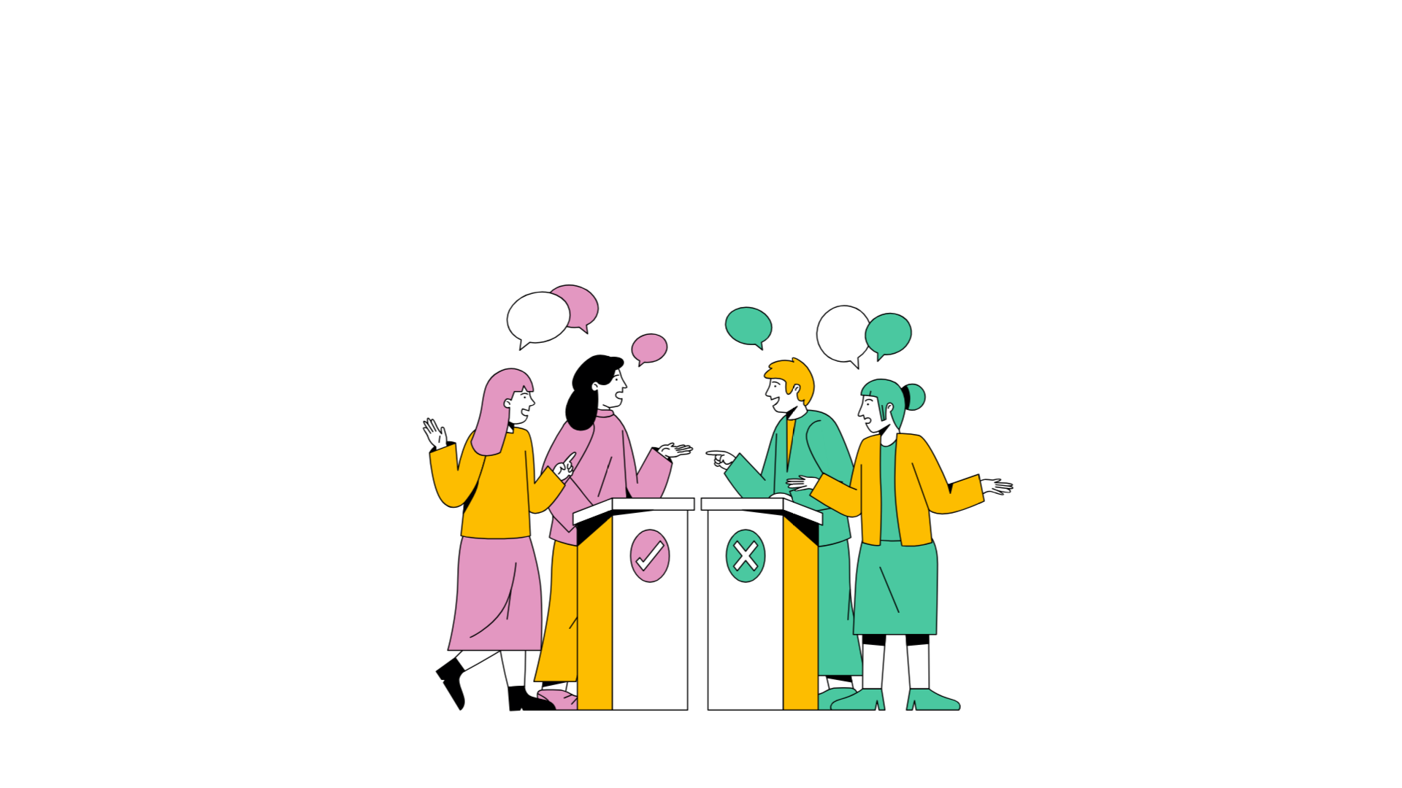
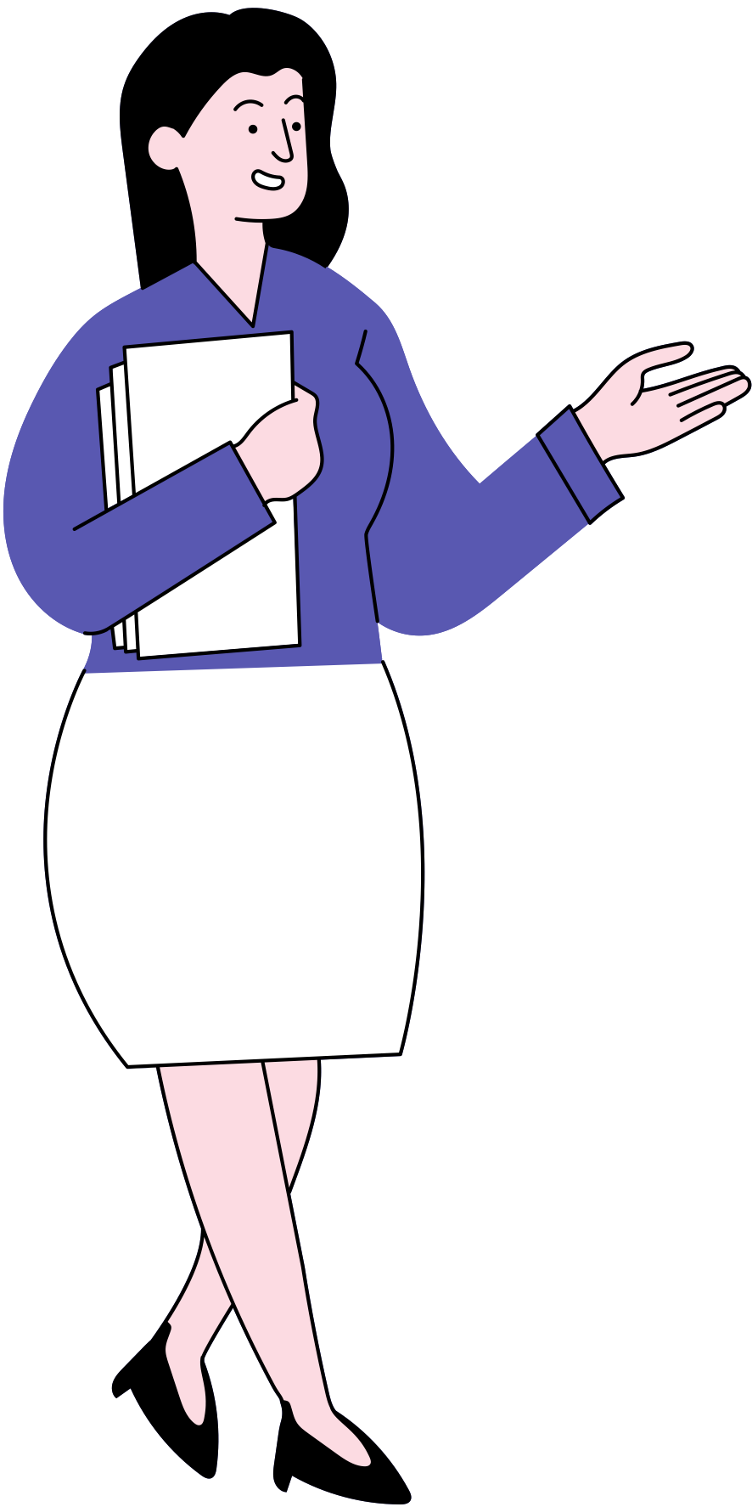
BEFORE THE INTRODUTION
Good morning, class! Today, let’s dive into a topic that’s like the architect’s blueprint for success in projects

Slide 2
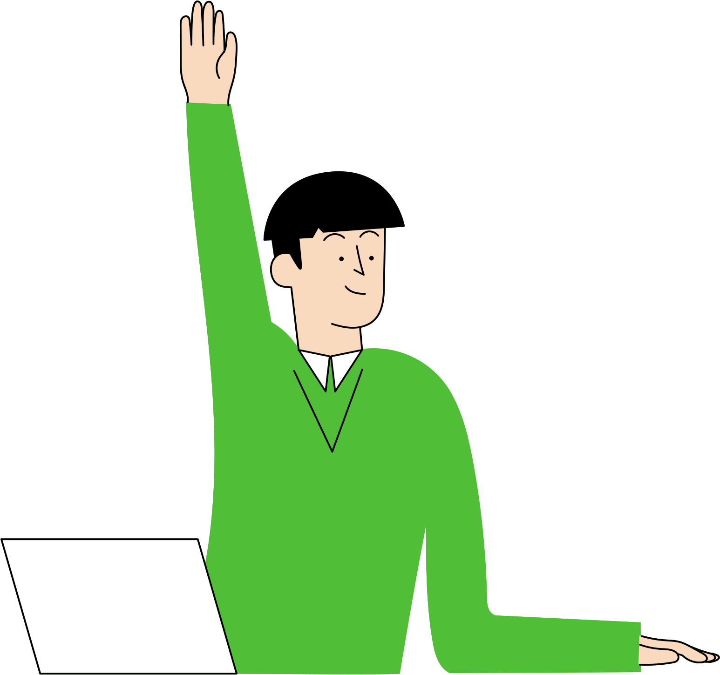
Is it strategic planning, Ms. Rodriguez?
Brilliant, Alex! Now, let me throw another question at you all. Ever been in a situation where a project felt like putting together a puzzle without seeing the big picture first?

Slide 3

Oh, definitely! It gets chaotic, and sometimes we end up redoing things.
Great answer! Today, we're talking about the top-down approach. Instead of starting from the ground up, we're going to start from the mountaintop and work our way down.
Think of it as building a skyscraper – you start with the overall structure before focusing on the details.

Slide 4
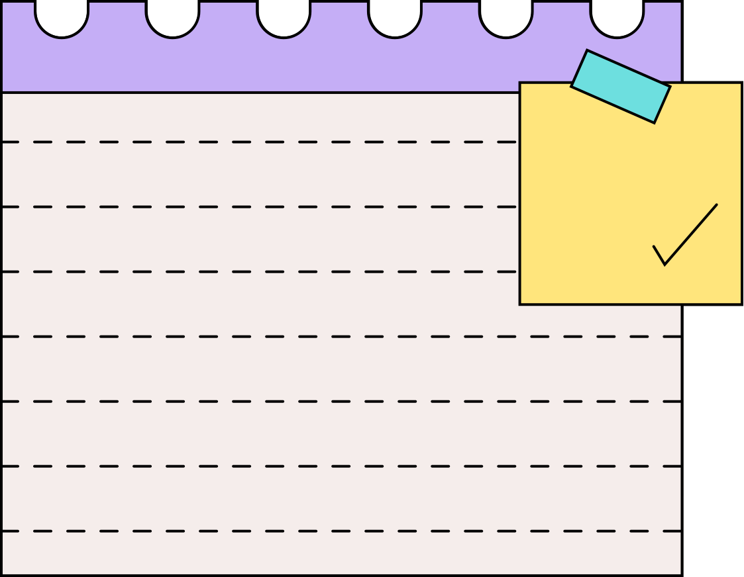
WHAT IS A TOP-DOWN APPROACH?
A top-down approach is a method of problem-solving, planning, or project implementation that involves starting with a broad overview and progressively breaking it down into smaller, more detailed components.
Do you think it’s to risk when make a strategic in various fields that approach from the top to bottom?

Slide 5
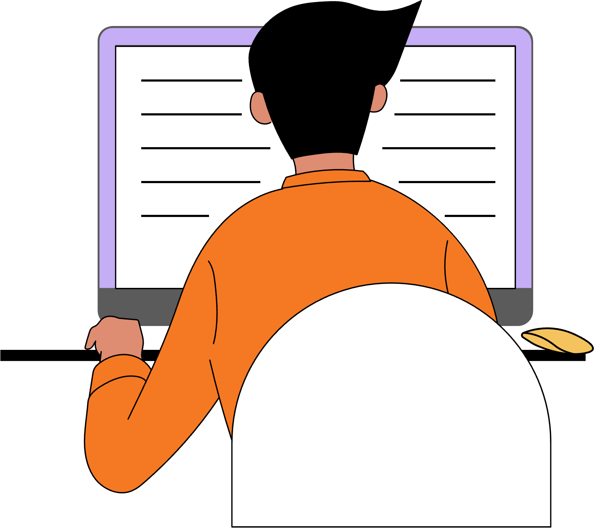
WRITING
A THESIS STATEMENT
for College

Slide 6
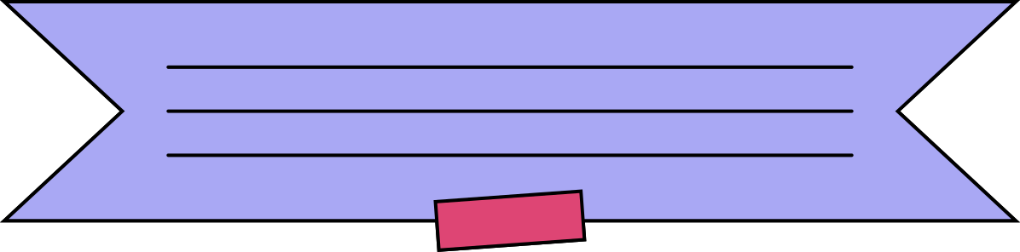

HOW TO USE THIS PRESENTATION
GoogleSlides
PowerPoint
Canva
Click on the "Google Slides" button below this presentation preview. Make sure to sign in to your Google account. Click on "Make a copy." Start editing your presentation.
Alternative: Click on the "Share" button on the top right corner in Canva and click on "More" at the bottom of the menu. Enter "Google Drive" in the search bar and click on the GDrive icon to add this design as a Google slide in your GDrive.
Click on the "PowerPoint" button below this presentation preview. Start editing your presentation.
Alternative: From Canva template file, Click on the "Share" button on the top right corner in Canva and click on "More" at the bottom of the menu. Enter "PowerPoint" in the search bar and click on the PowerPoint icon to download.
Click on the "Canva" button under this presentation preview. Start editing your presentation. You need to sign in to your Canva account.

Slide 7



The definition
and purpose of a thesis statement.
LEARNING OBJECTIVES
How to construct clear and effective arguments.
By the end of this lesson, you will understand . . .
How to maintain a formal writing style in your writing.

Slide 8
WHAT IS A THESIS STATEMENT?
You can think of a thesis statement as
the "glue" that holds
a piece of persuasive writing together.
A thesis statement is a sentence that clearly and concisely presents the main point or argument in a piece of persuasive writing (usually essays and debates).

Slide 9

HOW ARE THESIS STATEMENTS USED?
A thesis statement is usually stated clearly in the introductory paragraph of a persausive text, and repeated again (in slightly different words) throughout the body paragraphs, and in the conclusion paragraph as well.
Thesis statements provide structure to persuasive writing and helps readers to understand where the writing is headed.

Slide 10
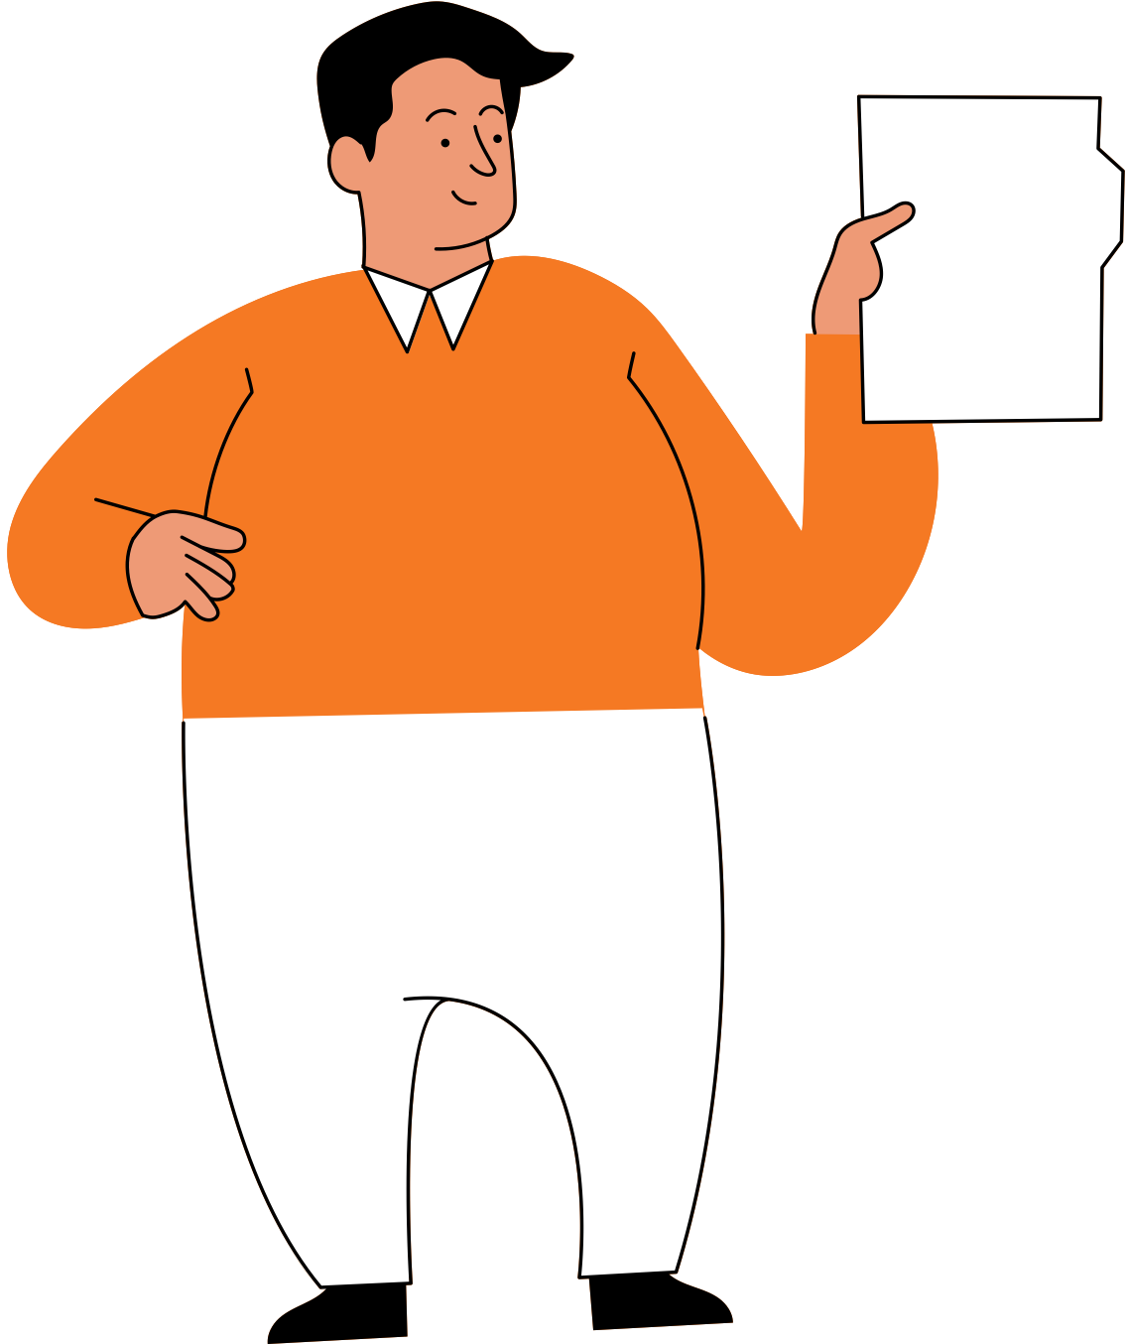
YOUR MISSION
Your mission today will be to come up with an answer to the following question:
Does technology bring us closer together, or push us further apart?
Your argument (thesis statement) will answer the question above and should be supported with at least 3 reasons.

Slide 11
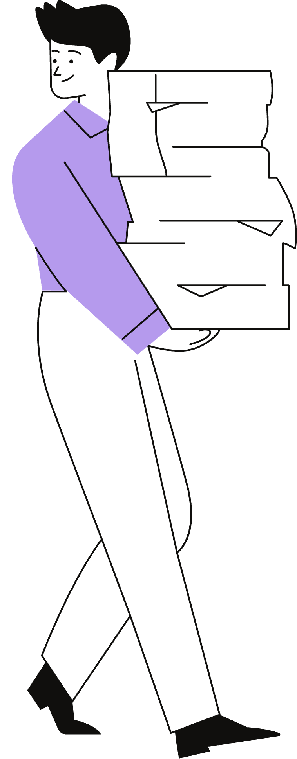

OPINIONS ON THE TOPIC
Let's cosider both sides of the argument.
With the rise of technology, many people are feeling more connected than ever. It can help us to connect with our friends and family from anywhere in the world.
On the other hand, some feel that technology pushes us further apart. It can distract us from spending quality time together and make us feel more isolated.

Slide 12
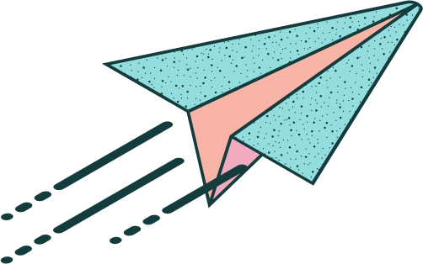
WHAT DO YOU BELIEVE?
Let's practice creating some arguments!
If you believe that technology brings us closer together, move to the left.
If you believe that technology pushes us further apart, move to the right.

Slide 13



Brainstorm: Write down your reasons
for your opinion.
DEVELOPING YOUR ARGUMENTS
Discuss: Talk and listen about your
and others' ideas.
Work in small groups (2-3 people) to develop your arguments.
Record: Write down the reasons you discussed.

Slide 14
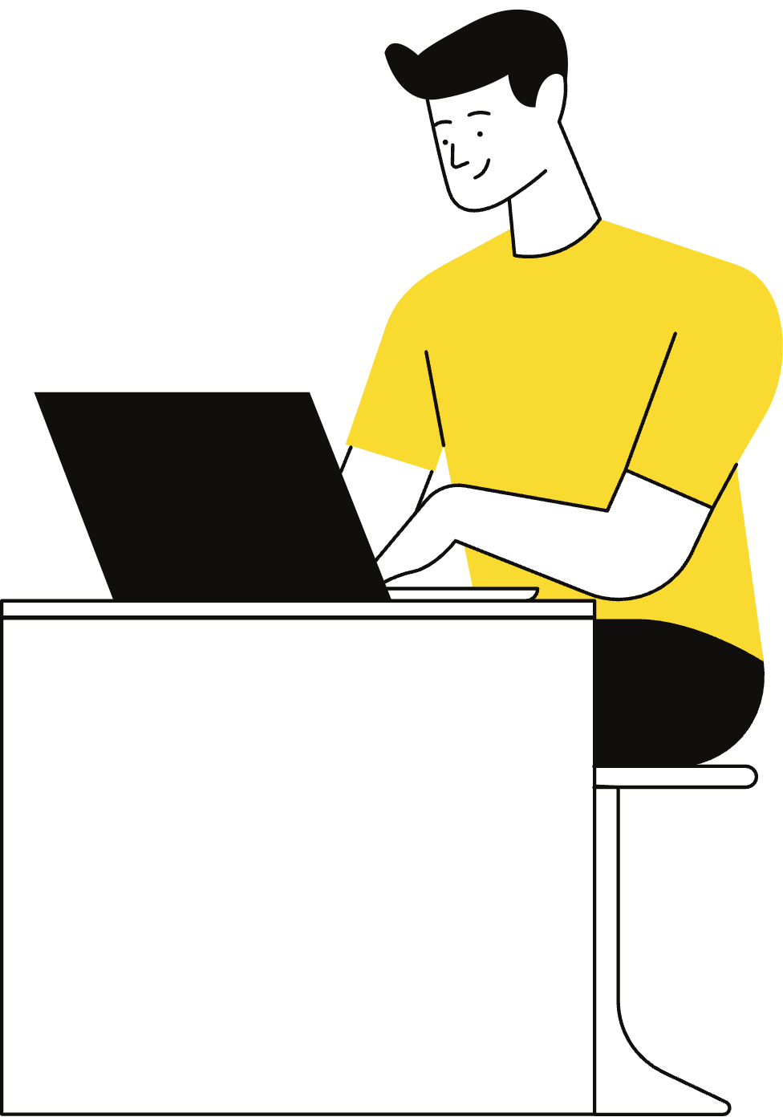
FINDING EVIDENCE
Now that you have come up with some reasons to support your argument, work in small groups to research and find evidence for those reasons.
If you can't find evidence, it's okay to reconsider some of your reasons. You should try to find evidence for at least 3 of your reasons.
Write down the evidence you find and make sure to use trustworthy and reliable sources.

Slide 15
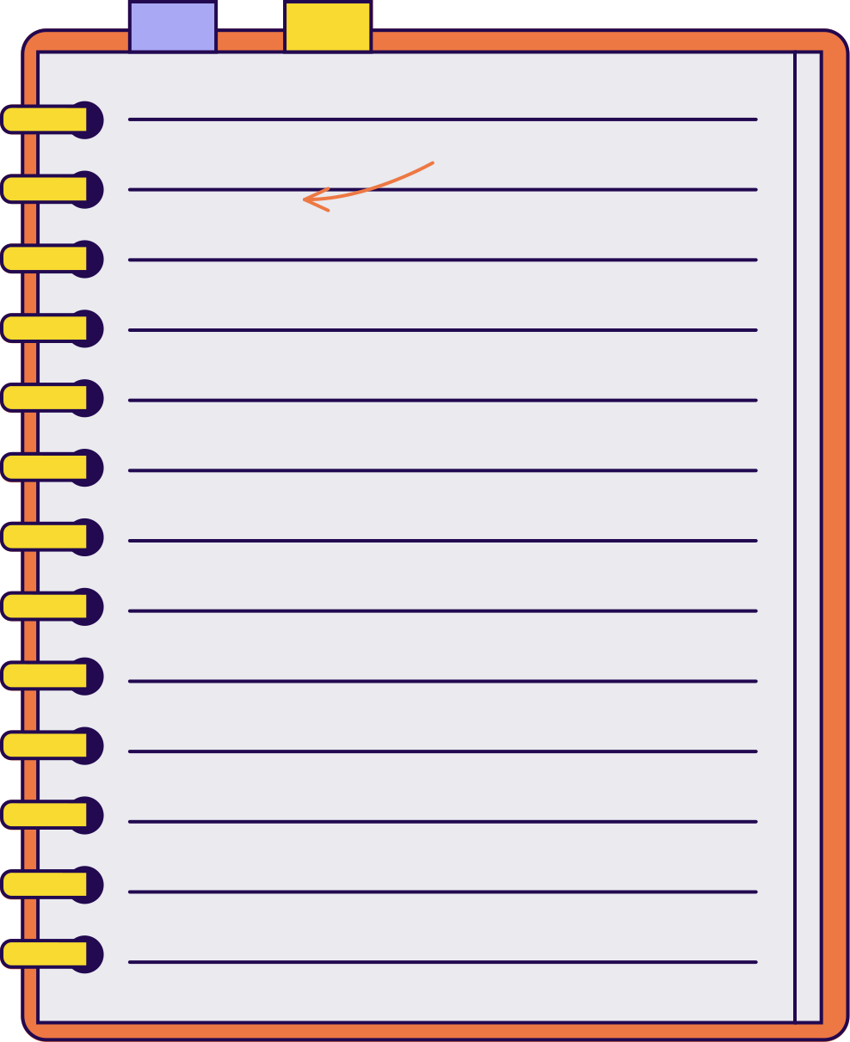
DEVELOPING YOUR THESIS
Now that you have your 3 reasons and evidence, it's time to create a thesis statement.
To do that, we have to go back to our original question: Does technology bring us closer together, or push us further apart?

Slide 16

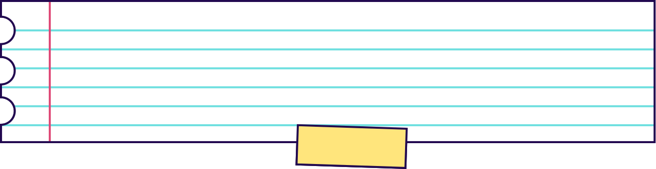
DEVELOPING YOUR THESIS
Let's turn your answer and reasons into a thesis statement.
Remember the question you are answering is:
Does technology bring us closer
together, or push us further apart?

Slide 17
DEVELOPING YOUR THESIS
In order to write your thesis, you need to combine your original answer with your 3 main reasons. See the example below for how this might look.
Answer
Technology pushes us further apart.
Reason 1
Reason 2
Reason 3
Technology keeps us from spending quality time with loved ones.
Seeing perfect lives online can make us feel insecure or unhappy.
Too much technology makes us less active and more unhealthy.

Slide 18
The next thing you want to do is write out your argument and your 3 reasons all as one sentence.
Let's go back to our example to see how that might look.
PUTTING IT ALL TOGETHER

Slide 19
PUTTING IT ALL TOGETHER
Answer
Technology pushes us further apart.
Reason 1
Reason 2
Reason 3
Technology keeps us from spending quality time with loved ones.
Seeing perfect lives online can make us feel insecure or unhappy.
Too much technology makes us less active and more unhealthy.
Thesis Statement
Technology pushes us further apart as it keeps us from spending quality time with loved ones, it can make us feel insecure or unhappy, and it can make us less active and more unhealthy.

Slide 20

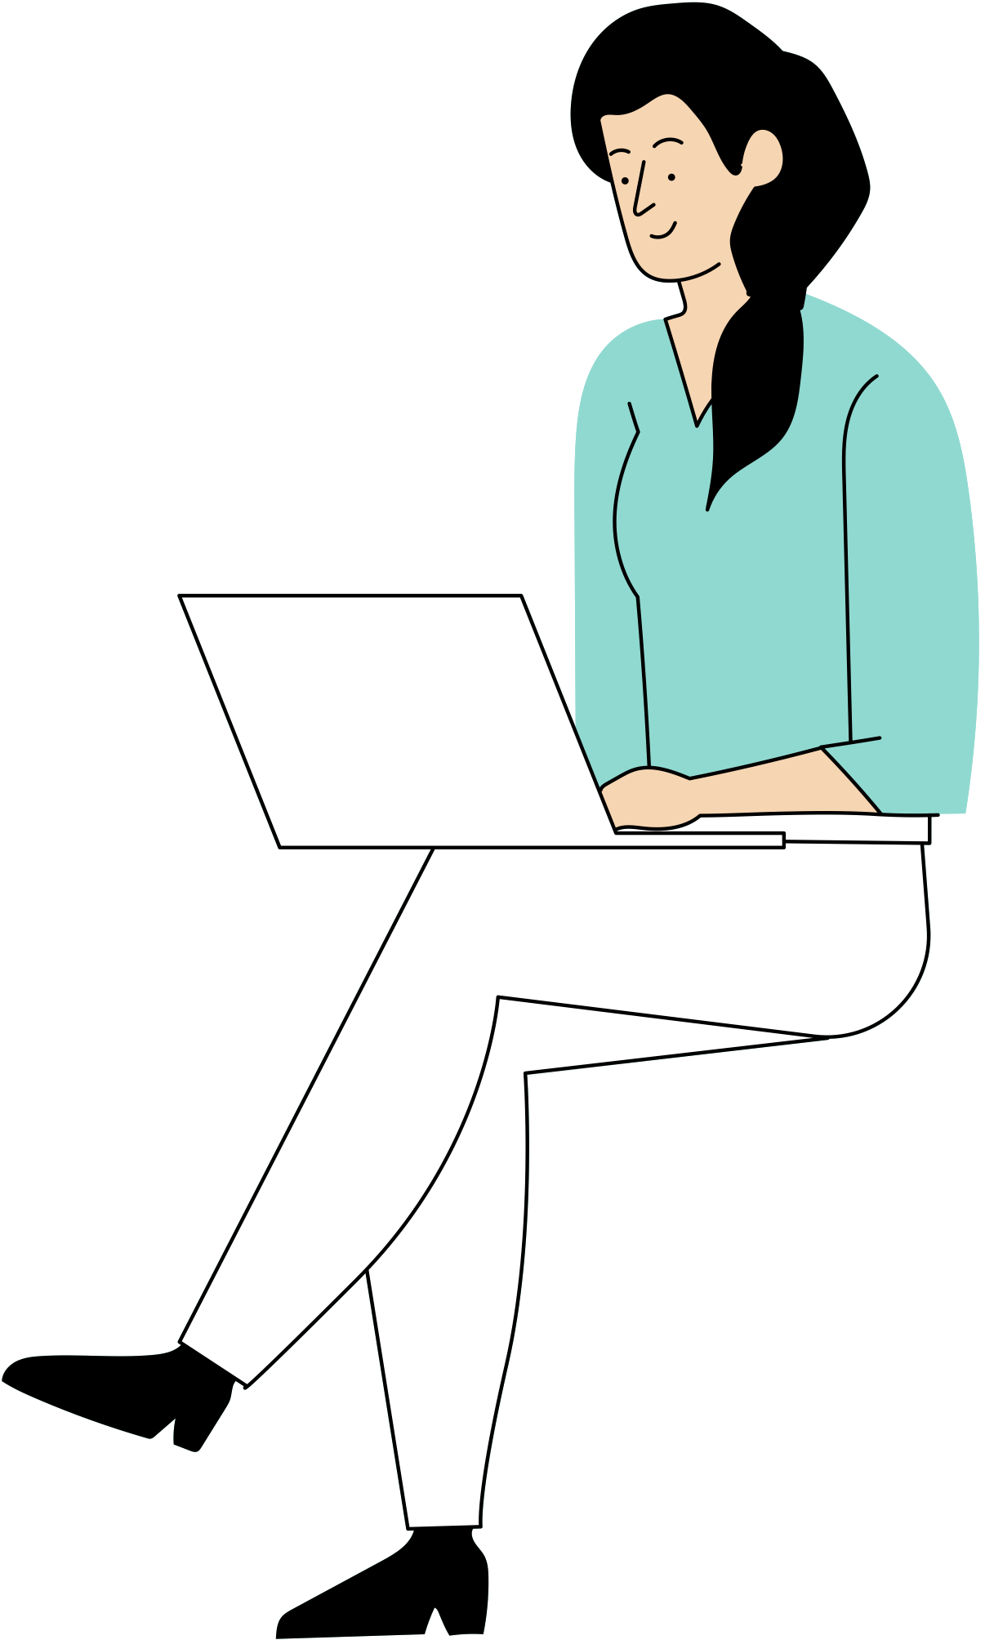
MAINTAINING A FORMAL STYLE
It is important to maintain a formal style when writing persuasively.
It is also very important to write your thesis in a formal style because it helps you sound more convincing and allows your readers to trust that you're an expert on the topic.

Slide 21


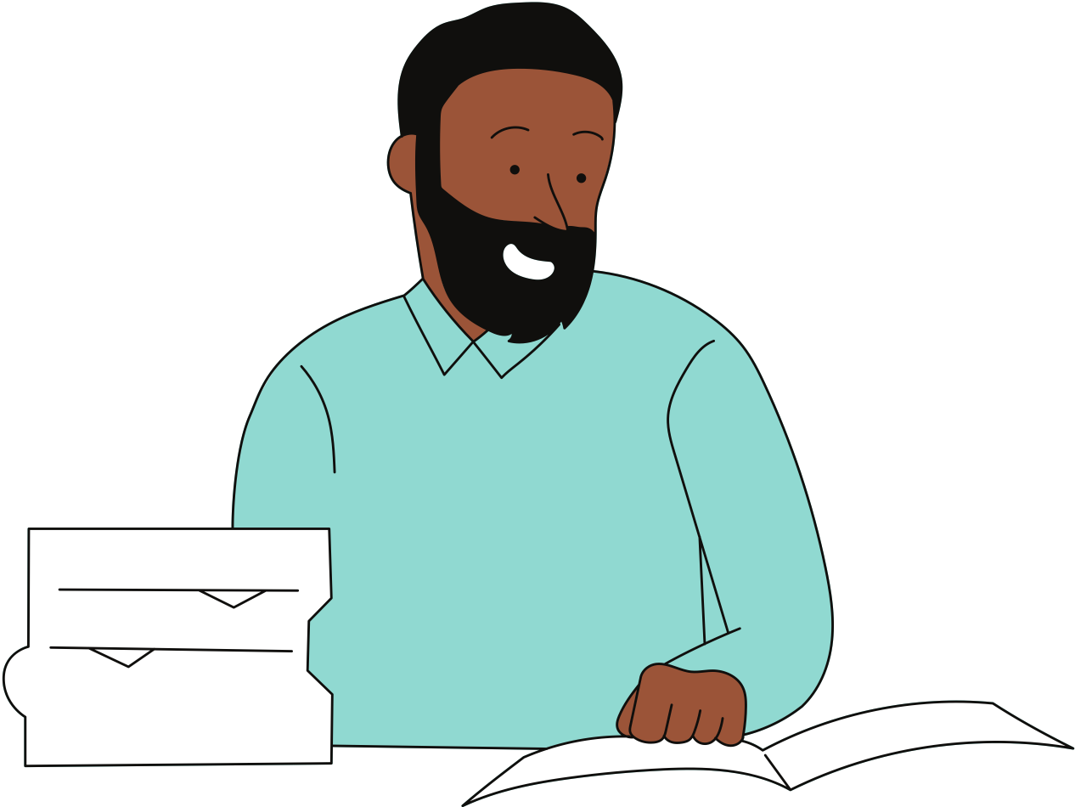


MAINTAINING A FORMAL STYLE
Eliminate personal pronouns (e.g. "I" or "you").
Incorporate expert opinions or scholarly consensus.
Some tips for writing your thesis statements in a formal style.
Use precise and academic language.
Clearly state your opinion, avoiding vague language.

Slide 22

MAINTAINING A FORMAL STYLE
See the example below which shows an improved thesis statement.
Original Thesis
Improved Thesis
Technology pushes us further apart as it keeps us from spending quality time with loved ones, it can make us feel insecure or unhappy, and it can make us less active and more unhealthy.
Technology has the potential to create distance between people, impede quality time with loved ones, create feelings of insecurity and unhappiness, and contribute to an inactive and unhealthy lifestyle, as affirmed by experts in the field.

Slide 23


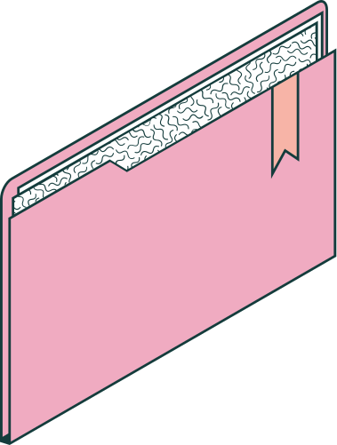
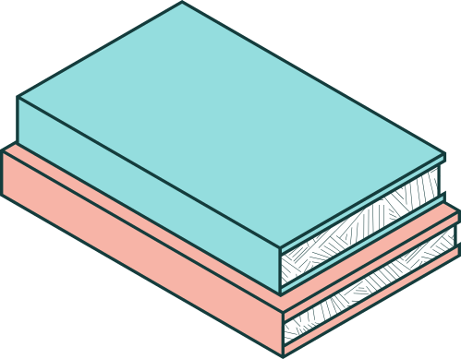
The definition and purpose of a thesis statement.
How to construct clear and effective arguments.
THANK YOU
FOR LISTENING!
How to maintain a formal writing style in your writing.
Today, you have learned how to write a thesis statement and should now understand . . .

Slide 24
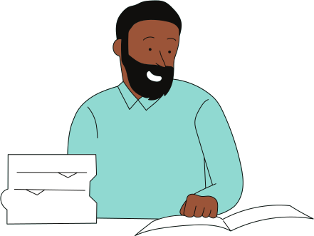

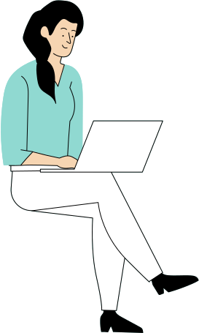
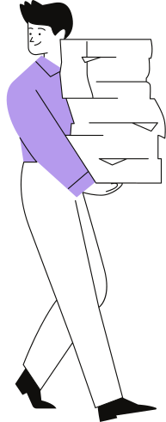

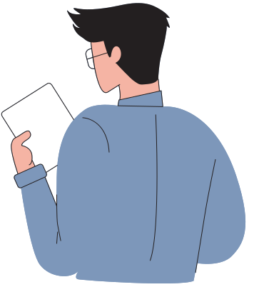

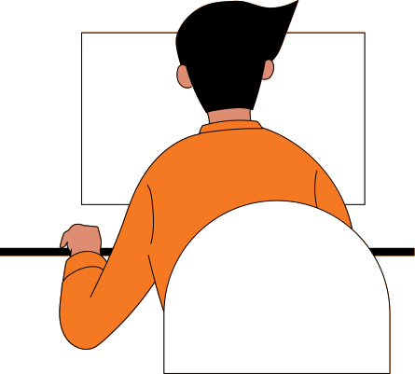


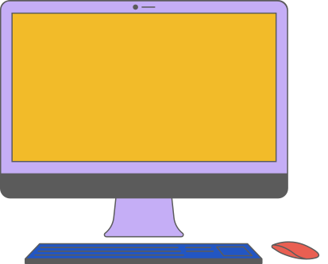




RESOURCE
PAGE
Use these design resources
in your Canva Presentation.
This presentation template
uses the following free fonts:
Titles: Titillium Web
Headers: Titillium Web
Body Copy: Titillium Web
You can find these fonts
online too. Happy designing!
Don't forget to delete this
page before presenting.

Slide 25

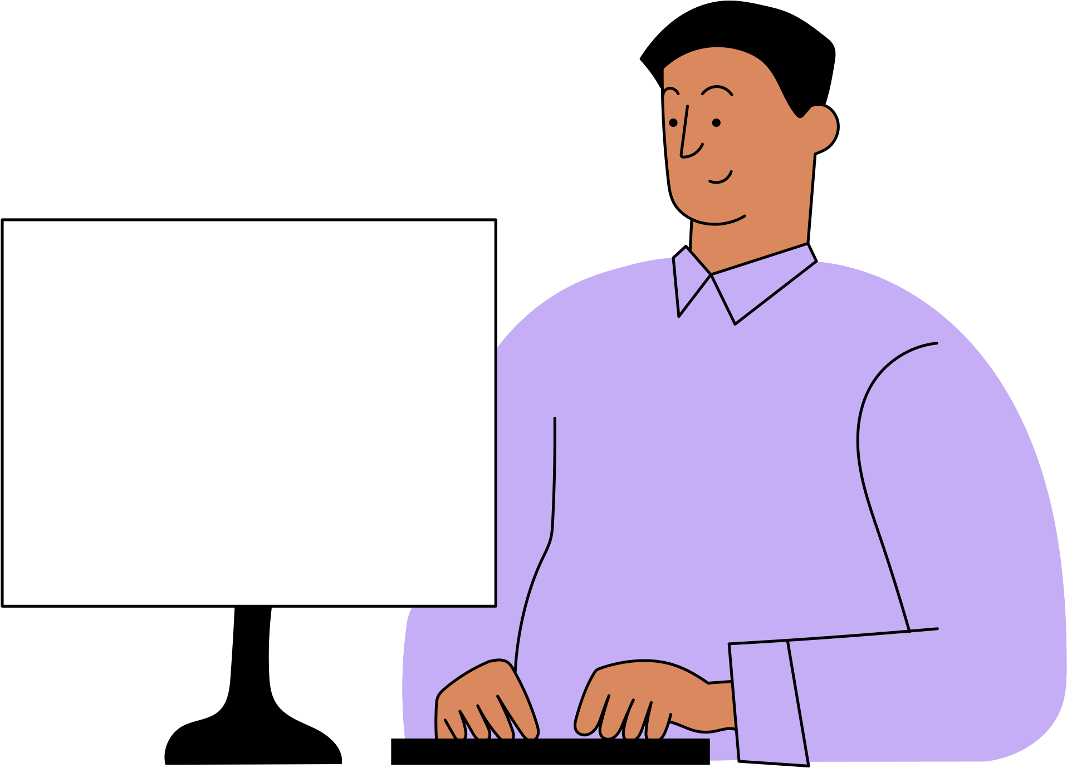
CREDITS
SLIDESCARNIVAL
This presentation template is free for everyone to use thanks to the following:
for the presentation template
PEXELS
for the photos

